Slide 1
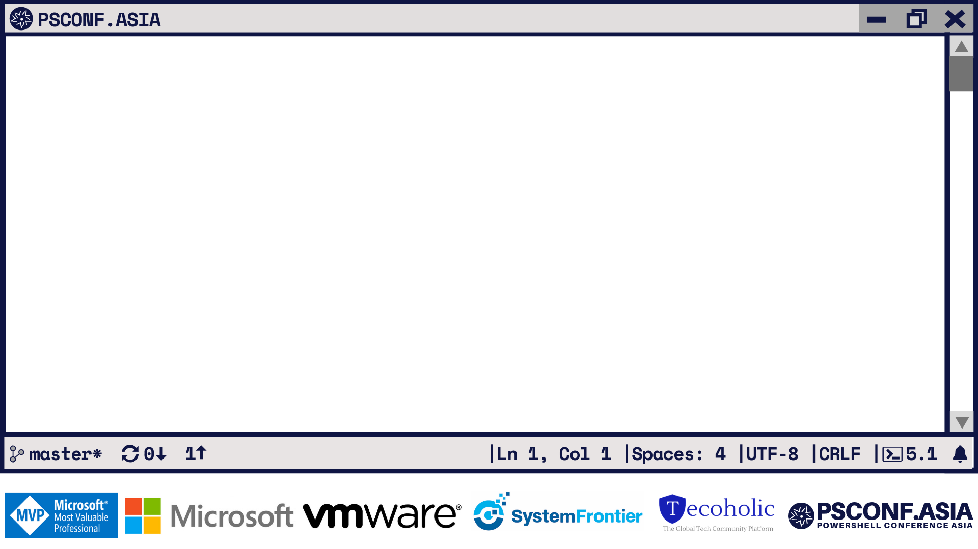
Visualize & Document Infrastructure with PowerShell

Slide 2












PS C: >_ whoami
TECH. WRITER FOR
BOOKS AUTHORED
CONTRIBUTING AUTHOR
PRATEEK SINGH
RIDICURIOUS.COM
/SINGHPRATEIK
/PRATEEKKUMARSINGH
/RIDICULOUSLYCURIOUS
LEANPUB.COM/B/BOOKS

Slide 3

““The purpose of visualization is insight, not pictures.”
Ben Shneiderman

Slide 4
PS C: >_ Get-Agenda
Basics of GraphViz and PSGraph Module
Simple use cases
Directory Tree visualization
Netstat local-remote port visualization
Network
Port Testing - Telnet
Reachability - Test-Connection
Active Directory
Org chart
Hyper-V visualization
Azure Resource Group Topology diagram

Slide 5

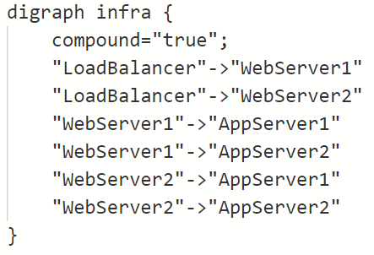
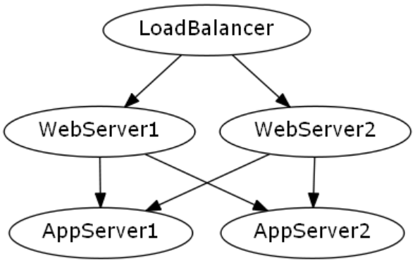

PS C: >_ GraphViz
Open source
Graph visualization software
Structural information to graphs
Simple text to automated diagrams
Applications in:
Software engineering
Database and Web Design
Networking and other domains
INPUT
OUTPUT
Graph Visualization Engine
DOT Language
PNG, SVG, JPEG, PDF

Slide 6

PS C: >_ PSGraph Module
PowerShell based Graph visualization
Built upon GraphViz Engine
Open sourced on Github https://github.com/KevinMarquette/PSGraph
Cross platform (Win, Linux and MacOS)
Implemented as a DSL or Domain Specific Language

Slide 7
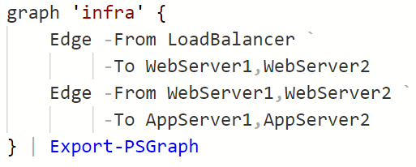
PS C: >_ PSGraph Module
DSL
(Domain Specific Language)
INPUT
OUTPUT
Graph Visualization Engine
PNG, SVG, JPEG, PDF
DOT Language

Slide 8

That’s fine but what’s so special !

Slide 9
“If your only tool is a hammer,
every problem looks like a nail.”
“If all you have is a hammer, everything looks like a nail.”
Abraham Maslow
The Psychology of Science, published in 1966.
Different problems require different solutions
Favorite Right tool for the right job
Law of Instrument

Slide 10




Manual
Time consuming
Planning Phase
No Scripting
More Control
Draw.io
Automated
Maintainable
Live Infrastructure
Engineers & Devs
Asset while troubleshooting
+

Slide 11

PS C: >_ Start-Demo
“Talk is cheap. Show me the code.”
-Linus Torvalds

Slide 12
DEMO – 1 Getting Started with
PSGraph Module

Slide 13
DEMO – 2 Advance Use cases

Slide 14
PS C: >_ Get-Resource
Official Website of GraphViz
https://www.graphviz.org/
Use cases, API’s and Language Bindings https://github.com/CodeFreezr/awesome-graphviz
PSGraph Documentation
https://psgraph.readthedocs.io
Slides
https://github.com/prateekkumarsingh/presentations

Slide 15
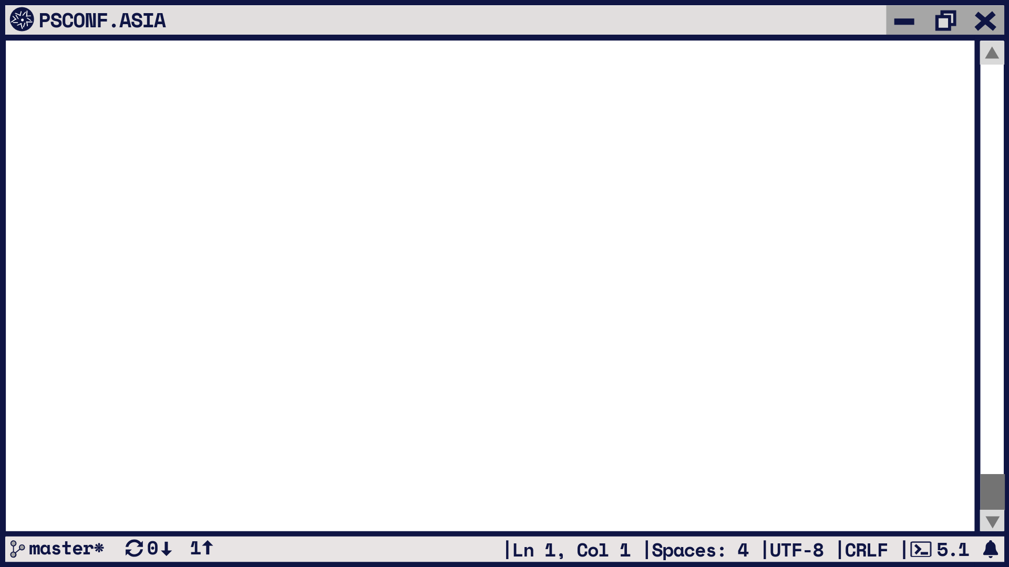



Slide 16
PS C: >_ whoami
TECH. WRITER FOR
BOOKS AUTHORED
CONTRIBUTING AUTHOR
PRATEEK SINGH
RIDICURIOUS.COM
/SINGHPRATEIK
/PRATEEKKUMARSINGH
/RIDICULOUSLYCURIOUS
LEANPUB.COM/B/BOOKS

